Slide 1
Support Vector Machines
Andrew W. Moore
Professor
School of Computer Science
Carnegie Mellon University
www.cs.cmu.edu/~awm
awm@cs.cmu.edu
412-268-7599
Note to other teachers and users of these slides. Andrew would be delighted if you found this source material useful in giving your own lectures. Feel free to use these slides verbatim, or to modify them to fit your own needs. PowerPoint originals are available. If you make use of a significant portion of these slides in your own lecture, please include this message, or the following link to the source repository of Andrew’s tutorials: http://www.cs.cmu.edu/~awm/tutorials . Comments and corrections gratefully received.

Slide 2
Linear Classifiers
α
x
f
y^{est}
f(x,w,b) = sign(w. x - b)
denotes +1
denotes -1
How would you classify this data?

Slide 3
Linear Classifiers
α
x
f
y^{est}
f(x,w,b) = sign(w. x - b)
denotes +1
denotes -1
How would you classify this data?

Slide 4
Linear Classifiers
α
x
f
y^{est}
f(x,w,b) = sign(w. x - b)
denotes +1
denotes -1
How would you classify this data?

Slide 5
Linear Classifiers
α
x
f
y^{est}
f(x,w,b) = sign(w. x - b)
denotes +1
denotes -1
How would you classify this data?

Slide 6
Linear Classifiers
α
x
f
y^{est}
f(x,w,b) = sign(w. x - b)
denotes +1
denotes -1
Any of these would be fine..
..but which is best?

Slide 7
Classifier Margin
α
x
f
y^{est}
f(x,w,b) = sign(w. x - b)
denotes +1
denotes -1
Define the margin of a linear classifier as the width that the boundary could be increased by before hitting a datapoint.

Slide 8
Maximum Margin
α
x
f
y^{est}
f(x,w,b) = sign(w. x - b)
denotes +1
denotes -1
The maximum margin linear classifier is the linear classifier with the, um, maximum margin.
This is the simplest kind of SVM (Called an LSVM)
Linear SVM

Slide 9
Maximum Margin
α
x
f
y^{est}
f(x,w,b) = sign(w. x - b)
denotes +1
denotes -1
The maximum margin linear classifier is the linear classifier with the, um, maximum margin.
This is the simplest kind of SVM (Called an LSVM)
Support Vectors are those datapoints that the margin pushes up against
Linear SVM

Slide 10
Why Maximum Margin?
Intuitively this feels safest.
If we’ve made a small error in the location of the boundary (it’s been jolted in its perpendicular direction) this gives us least chance of causing a misclassification.
LOOCV is easy since the model is immune to removal of any non-support-vector datapoints.
There’s some theory (using VC dimension) that is related to (but not the same as) the proposition that this is a good thing.
Empirically it works very very well.
f(x,w,b) = sign(w. x - b)
denotes +1
denotes -1
The maximum margin linear classifier is the linear classifier with the, um, maximum margin.
This is the simplest kind of SVM (Called an LSVM)
Support Vectors are those datapoints that the margin pushes up against

Slide 11
Specifying a line and margin
Plus-Plane
“Predict Class = +1” zone
Classifier Boundary
Minus-Plane
“Predict Class = -1” zone
How do we represent this mathematically?
…in m input dimensions?

Slide 12
Specifying a line and margin
Plus-Plane
“Predict Class = +1” zone
Classifier Boundary
Minus-Plane
“Predict Class = -1” zone
wx+b=1
wx+b=0
wx+b=-1
Plus-plane = { x : w . x + b = +1 }
Minus-plane = { x : w . x + b = -1 }
Classify as.. | +1 | if | w . x + b >= 1
 | -1 | if | w . x + b <= -1
 | Universe explodes | if | -1 < w . x + b < 1

Slide 13
Computing the margin width
M = Margin Width
“Predict Class = +1” zone
How do we compute M in terms of w and b?
“Predict Class = -1” zone
wx+b=1
wx+b=0
wx+b=-1
Plus-plane = { x : w . x + b = +1 }
Minus-plane = { x : w . x + b = -1 }
Claim: The vector w is perpendicular to the Plus Plane. Why?

Slide 14
Computing the margin width
M = Margin Width
“Predict Class = +1” zone
How do we compute M in terms of w and b?
“Predict Class = -1” zone
wx+b=1
wx+b=0
wx+b=-1
Plus-plane = { x : w . x + b = +1 }
Minus-plane = { x : w . x + b = -1 }
Claim: The vector w is perpendicular to the Plus Plane. Why?
Let u and v be two vectors on the Plus Plane. What is w . ( u – v ) ?
And so of course the vector w is also perpendicular to the Minus Plane

Slide 15
Computing the margin width
x⁺
M = Margin Width
“Predict Class = +1” zone
How do we compute M in terms of w and b?
x⁻
“Predict Class = -1” zone
wx+b=1
wx+b=0
wx+b=-1
Plus-plane = { x : w . x + b = +1 }
Minus-plane = { x : w . x + b = -1 }
The vector w is perpendicular to the Plus Plane
Let x⁻ be any point on the minus plane
Let x⁺ be the closest plus-plane-point to x⁻.
Any location in ^{m}: not necessarily a datapoint
Any location in R^{m}: not necessarily a datapoint

Slide 16
Computing the margin width
x⁺
M = Margin Width
“Predict Class = +1” zone
How do we compute M in terms of w and b?
x⁻
“Predict Class = -1” zone
wx+b=1
wx+b=0
wx+b=-1
Plus-plane = { x : w . x + b = +1 }
Minus-plane = { x : w . x + b = -1 }
The vector w is perpendicular to the Plus Plane
Let x⁻ be any point on the minus plane
Let x⁺ be the closest plus-plane-point to x⁻.
Claim: x⁺ = x⁻ + λ w for some value of λ. Why?

Slide 17
Computing the margin width
x⁺
M = Margin Width
“Predict Class = +1” zone
The line from x⁻ to x⁺ is perpendicular to the planes.
So to get from x⁻ to x⁺ travel some distance in direction w.
How do we compute M in terms of w and b?
x⁻
“Predict Class = -1” zone
wx+b=1
wx+b=0
wx+b=-1
Plus-plane = { x : w . x + b = +1 }
Minus-plane = { x : w . x + b = -1 }
The vector w is perpendicular to the Plus Plane
Let x⁻ be any point on the minus plane
Let x⁺ be the closest plus-plane-point to x⁻.
Claim: x⁺ = x⁻ + λ w for some value of λ. Why?

Slide 18
Computing the margin width
x⁺
M = Margin Width
“Predict Class = +1” zone
x⁻
“Predict Class = -1” zone
wx+b=1
wx+b=0
wx+b=-1
What we know:
w . x⁺ + b = +1
w . x⁻ + b = -1
x⁺ = x⁻ + λ w
|x⁺ - x⁻ | = M
It’s now easy to get M in terms of w and b

Slide 19
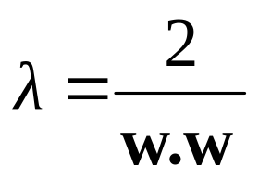
Computing the margin width
x⁺
M = Margin Width
“Predict Class = +1” zone
x⁻
“Predict Class = -1” zone
wx+b=1
wx+b=0
w . (x ⁻ + λ w) + b = 1
=>
w . x ⁻ + b + λ w .w = 1
=>
-1 + λ w .w = 1
=>
wx+b=-1
What we know:
w . x⁺ + b = +1
w . x⁻ + b = -1
x⁺ = x⁻ + λ w
|x⁺ - x⁻ | = M
It’s now easy to get M in terms of w and b

Slide 20
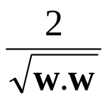
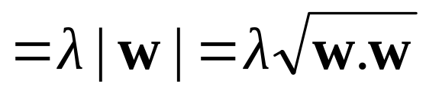
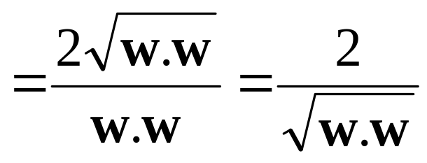
Computing the margin width
x⁺
M = Margin Width =
“Predict Class = +1” zone
x⁻
“Predict Class = -1” zone
wx+b=1
wx+b=0
M = |x⁺ - x⁻ | =| λ w |=
wx+b=-1
What we know:
w . x⁺ + b = +1
w . x⁻ + b = -1
x⁺ = x⁻ + λ w
|x⁺ - x⁻ | = M

Slide 21
Learning the Maximum Margin Classifier
x⁺
M = Margin Width =
“Predict Class = +1” zone
x⁻
“Predict Class = -1” zone
wx+b=1
wx+b=0
wx+b=-1
Given a guess of w and b we can
Compute whether all data points in the correct half-planes
Compute the width of the margin
So now we just need to write a program to search the space of w’s and b’s to find the widest margin that matches all the datapoints. How?
Gradient descent? Simulated Annealing? Matrix Inversion? EM? Newton’s Method?

Slide 22
Learning via Quadratic Programming
QP is a well-studied class of optimization algorithms to maximize a quadratic function of some real-valued variables subject to linear constraints.

Slide 23
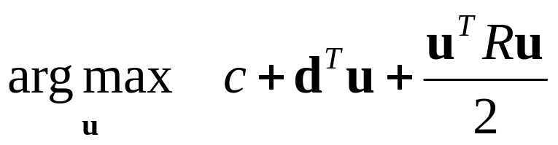
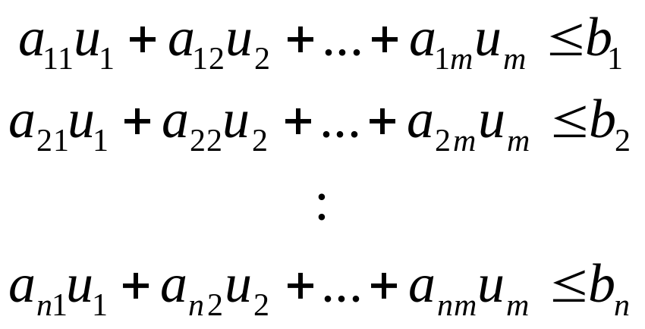
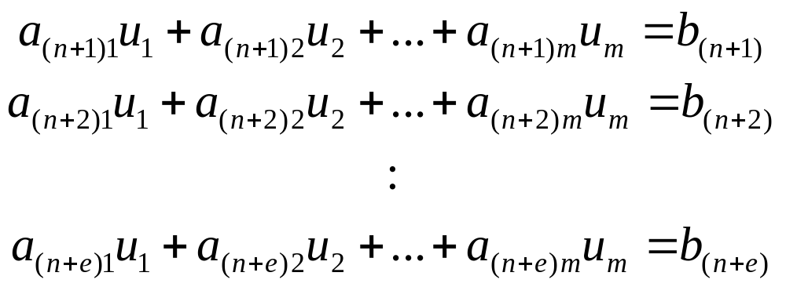
Quadratic Programming
Find
Quadratic criterion
Subject to
n additional linear inequality constraints
And subject to
e additional linear equality constraints

Slide 24
Quadratic Programming
Find
Quadratic criterion
There exist algorithms for finding such constrained quadratic optima much more efficiently and reliably than gradient ascent.
(But they are very fiddly…you probably don’t want to write one yourself)
Subject to
n additional linear inequality constraints
And subject to
e additional linear equality constraints

Slide 25
Learning the Maximum Margin Classifier
M =
Given guess of w , b we can
Compute whether all data points are in the correct half-planes
Compute the margin width
Assume R datapoints, each (x_{k},y_{k}) where y_{k} = +/- 1
“Predict Class = +1” zone
“Predict Class = -1” zone
wx+b=1
wx+b=0
wx+b=-1
What should our quadratic optimization criterion be?
How many constraints will we have?
What should they be?

Slide 26
Learning the Maximum Margin Classifier
M =
Given guess of w , b we can
Compute whether all data points are in the correct half-planes
Compute the margin width
Assume R datapoints, each (x_{k},y_{k}) where y_{k} = +/- 1
“Predict Class = +1” zone
“Predict Class = -1” zone
wx+b=1
wx+b=0
wx+b=-1
What should our quadratic optimization criterion be?
Minimize w.w
How many constraints will we have? R
What should they be?
w . x_{k} + b >= 1 if y_{k} = 1
w . x_{k} + b <= -1 if y_{k} = -1

Slide 27
Uh-oh!
This is going to be a problem!
What should we do?
denotes +1
denotes -1

Slide 28
Uh-oh!
This is going to be a problem!
What should we do?
Idea 1:
  Find minimum w.w, while minimizing number of training set errors.
    Problemette: Two things to minimize makes for an ill-defined optimization
denotes +1
denotes -1

Slide 29
Uh-oh!
This is going to be a problem!
What should we do?
Idea 1.1:
  Minimize
  w.w + C (#train errors)
There’s a serious practical problem that’s about to make us reject this approach. Can you guess what it is?
denotes +1
denotes -1
Tradeoff parameter

Slide 30
Uh-oh!
This is going to be a problem!
What should we do?
Idea 1.1:
  Minimize
  w.w + C (#train errors)
There’s a serious practical problem that’s about to make us reject this approach. Can you guess what it is?
denotes +1
denotes -1
Tradeoff parameter
Can’t be expressed as a Quadratic Programming problem.
Solving it may be too slow.
(Also, doesn’t distinguish between disastrous errors and near misses)
So… any other ideas?

Slide 31
Uh-oh!
This is going to be a problem!
What should we do?
Idea 2.0:
  Minimize
  w.w + C (distance of error
  points to their
  correct place)
denotes +1
denotes -1

Slide 32
Learning Maximum Margin with Noise
M =
Given guess of w , b we can
Compute sum of distances of points to their correct zones
Compute the margin width
Assume R datapoints, each (x_{k},y_{k}) where y_{k} = +/- 1
wx+b=1
wx+b=0
wx+b=-1
What should our quadratic optimization criterion be?
How many constraints will we have?
What should they be?

Slide 33
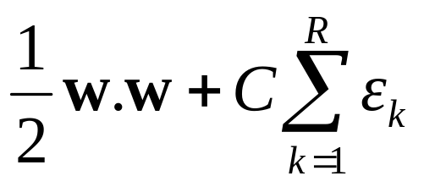
Learning Maximum Margin with Noise
ε₁₁
M =
Given guess of w , b we can
Compute sum of distances of points to their correct zones
Compute the margin width
Assume R datapoints, each (x_{k},y_{k}) where y_{k} = +/- 1
ε₂
wx+b=1
ε₇
wx+b=0
wx+b=-1
What should our quadratic optimization criterion be?
Minimize
How many constraints will we have? R
What should they be?
w . x_{k} + b >= 1-ε_{k} if y_{k} = 1
w . x_{k} + b <= -1+ε_{k} if y_{k} = -1

Slide 34
Learning Maximum Margin with Noise
m = # input dimensions
M =
Given guess of w , b we can
Compute sum of distances of points to their correct zones
Compute the margin width
Assume R datapoints, each (x_{k},y_{k}) where y_{k} = +/- 1
ε₁₁
ε₂
Our original (noiseless data) QP had m+1 variables: w₁, w₂, … w_{m}, and b.
Our new (noisy data) QP has m+1+R variables: w₁, w₂, … w_{m}, b, ε_{k} , ε₁ ,… ε_{R}
wx+b=1
ε₇
wx+b=0
wx+b=-1
What should our quadratic optimization criterion be?
Minimize
How many constraints will we have? R
What should they be?
w . x_{k} + b >= 1-ε_{k} if y_{k} = 1
w . x_{k} + b <= -1+ε_{k} if y_{k} = -1
R= # records

Slide 35
Learning Maximum Margin with Noise
M =
Given guess of w , b we can
Compute sum of distances of points to their correct zones
Compute the margin width
Assume R datapoints, each (x_{k},y_{k}) where y_{k} = +/- 1
ε₁₁
ε₂
wx+b=1
ε₇
wx+b=0
wx+b=-1
What should our quadratic optimization criterion be?
Minimize
How many constraints will we have? R
What should they be?
w . x_{k} + b >= 1-ε_{k} if y_{k} = 1
w . x_{k} + b <= -1+ε_{k} if y_{k} = -1
There’s a bug in this QP. Can you spot it?

Slide 36
Learning Maximum Margin with Noise
M =
Given guess of w , b we can
Compute sum of distances of points to their correct zones
Compute the margin width
Assume R datapoints, each (x_{k},y_{k}) where y_{k} = +/- 1
ε₁₁
ε₂
wx+b=1
ε₇
wx+b=0
wx+b=-1
What should our quadratic optimization criterion be?
Minimize
How many constraints will we have? 2R
What should they be?
w . x_{k} + b >= 1-ε_{k} if y_{k} = 1
w . x_{k} + b <= -1+ε_{k} if y_{k} = -1
ε_{k} >= 0 for all k

Slide 37
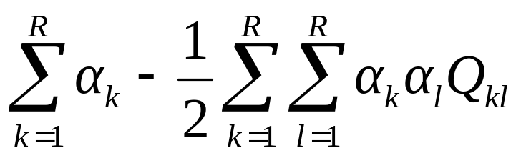
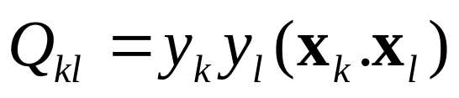
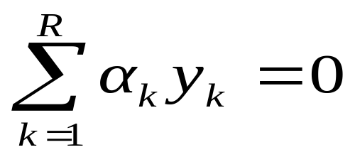
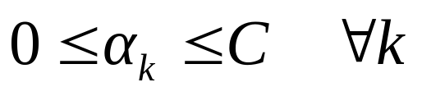
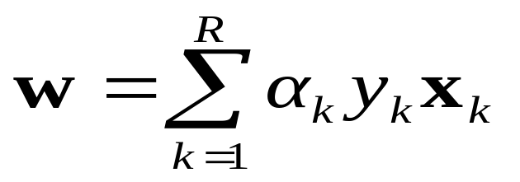
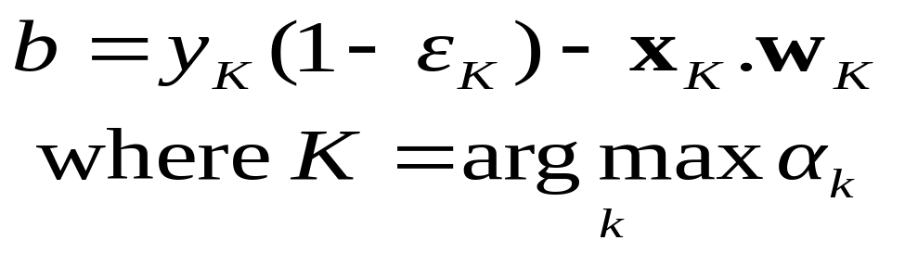
An Equivalent QP
Warning: up until Rong Zhang spotted my error in Oct 2003, this equation had been wrong in earlier versions of the notes. This version is correct.
Maximize
where
Subject to these constraints:
Then define:
Then classify with:
f(x,w,b) = sign(w. x - b)

Slide 38
An Equivalent QP
Warning: up until Rong Zhang spotted my error in Oct 2003, this equation had been wrong in earlier versions of the notes. This version is correct.
Maximize
where
Subject to these constraints:
Then define:
Datapoints with α_{k} > 0 will be the support vectors
Then classify with:
f(x,w,b) = sign(w. x - b)
..so this sum only needs to be over the support vectors.

Slide 39
An Equivalent QP
Why did I tell you about this equivalent QP?
It’s a formulation that QP packages can optimize more quickly
Because of further jaw-dropping developments you’re about to learn.
Maximize
where
Subject to these constraints:
Then define:
Datapoints with α_{k} > 0 will be the support vectors
Then classify with:
f(x,w,b) = sign(w. x - b)
..so this sum only needs to be over the support vectors.

Slide 40
Suppose we’re in 1-dimension
What would SVMs do with this data?
x=0

Slide 41
Suppose we’re in 1-dimension
Not a big surprise
x=0
Positive “plane”
Negative “plane”

Slide 42
Harder 1-dimensional dataset
That’s wiped the smirk off SVM’s face.
What can be done about this?
x=0

Slide 43
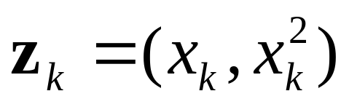
Harder 1-dimensional dataset
Remember how permitting non-linear basis functions made linear regression so much nicer?
Let’s permit them here too
x=0

Slide 44
Harder 1-dimensional dataset
Remember how permitting non-linear basis functions made linear regression so much nicer?
Let’s permit them here too
x=0

Slide 45
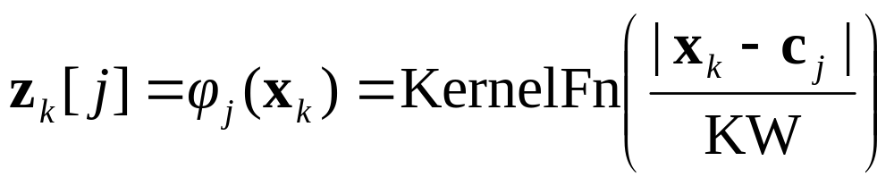
Common SVM basis functions
z_{k} = ( polynomial terms of x_{k} of degree 1 to q )
z_{k} = ( radial basis functions of x_{k} )
z_{k} = ( sigmoid functions of x_{k} )
This is sensible.
Is that the end of the story?
No…there’s one more trick!

Slide 46
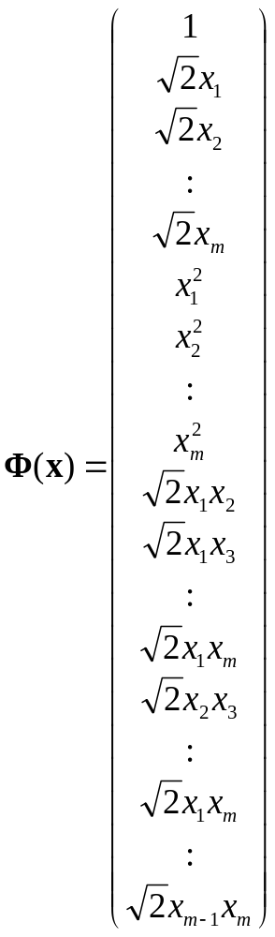

Quadratic Basis Functions
Constant Term
Linear Terms
Number of terms (assuming m input dimensions) = (m+2)-choose-2
= (m+2)(m+1)/2
= (as near as makes no difference) m²/2
You may be wondering what those
’s are doing.
You should be happy that they do no harm
You’ll find out why they’re there soon.
Pure Quadratic Terms
Quadratic Cross-Terms

Slide 47
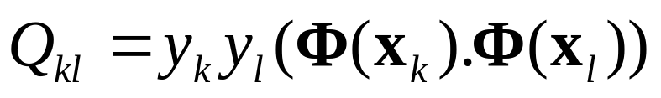
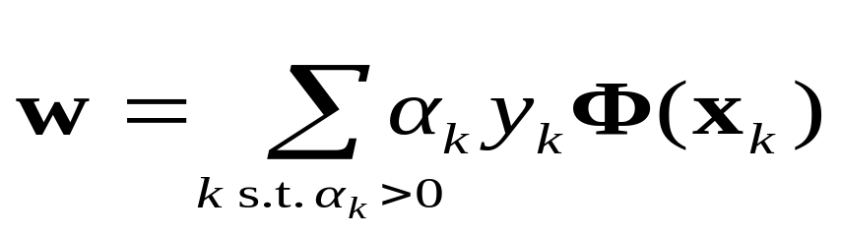
QP with basis functions
Warning: up until Rong Zhang spotted my error in Oct 2003, this equation had been wrong in earlier versions of the notes. This version is correct.
Maximize
where
Subject to these constraints:
Then define:
Then classify with:
f(x,w,b) = sign(w. φ(x) - b)

Slide 48
QP with basis functions
Maximize
where
We must do R²/2 dot products to get this matrix ready.
Each dot product requires m²/2 additions and multiplications
The whole thing costs R² m² /4. Yeeks!
…or does it?
Subject to these constraints:
Then define:
Then classify with:
f(x,w,b) = sign(w. φ(x) - b)

Slide 49
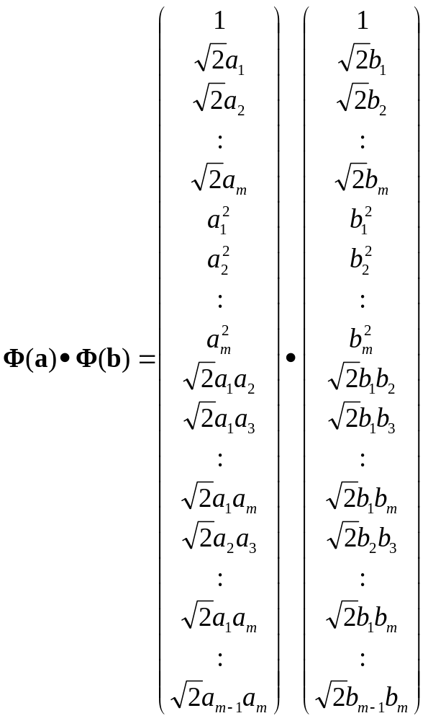
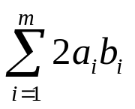
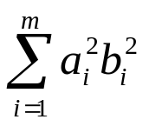
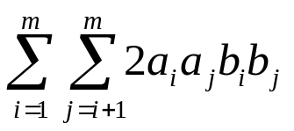
Quadratic Dot Products
+
+
+

Slide 50


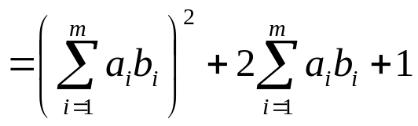

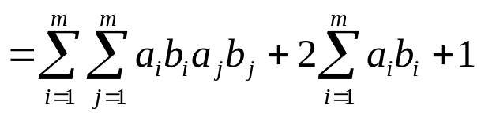
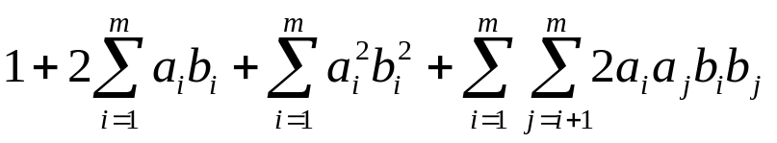
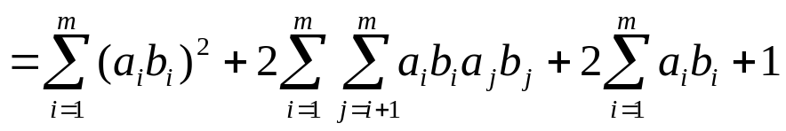
Quadratic Dot Products
Just out of casual, innocent, interest, let’s look at another function of a and b:

Slide 51
Quadratic Dot Products
Just out of casual, innocent, interest, let’s look at another function of a and b:
They’re the same!
And this is only O(m) to compute!

Slide 52
QP with Quadratic basis functions
Warning: up until Rong Zhang spotted my error in Oct 2003, this equation had been wrong in earlier versions of the notes. This version is correct.
Maximize
where
We must do R²/2 dot products to get this matrix ready.
Each dot product now only requires m additions and multiplications
Subject to these constraints:
Then define:
Then classify with:
f(x,w,b) = sign(w. φ(x) - b)

Slide 53
Higher Order Polynomials
Poly-nomial | φ(x) | Cost to build Q_{kl} matrix traditionally | Cost if 100 inputs | φ(a).φ(b) | Cost to build Q_{kl} matrix sneakily | Cost if 100 inputs
Quadratic | All m²/2 terms up to degree 2 | m² R² /4 | 2,500 R² | (a.b+1)² | m R² / 2 | 50 R²
Cubic | All m³/6 terms up to degree 3 | m³ R² /12 | 83,000 R² | (a.b+1)³ | m R² / 2 | 50 R²
Quartic | All m⁴/24 terms up to degree 4 | m⁴ R² /48 | 1,960,000 R² | (a.b+1)⁴ | m R² / 2 | 50 R²

Slide 54
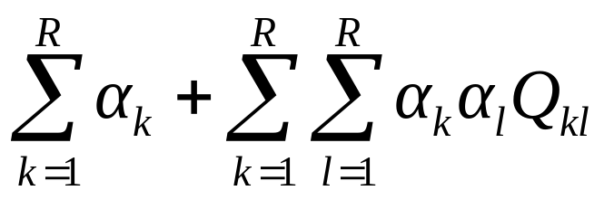
QP with Quintic basis functions
We must do R²/2 dot products to get this matrix ready.
In 100-d, each dot product now needs 103 operations instead of 75 million
But there are still worrying things lurking away. What are they?
Maximize
where
Subject to these constraints:
Then define:
Then classify with:
f(x,w,b) = sign(w. φ(x) - b)

Slide 55
QP with Quintic basis functions
We must do R²/2 dot products to get this matrix ready.
In 100-d, each dot product now needs 103 operations instead of 75 million
But there are still worrying things lurking away. What are they?
Maximize
where
Subject to these constraints:
The fear of overfitting with this enormous number of terms
The evaluation phase (doing a set of predictions on a test set) will be very expensive (why?)
Then define:
Then classify with:
f(x,w,b) = sign(w. φ(x) - b)

Slide 56
QP with Quintic basis functions
We must do R²/2 dot products to get this matrix ready.
In 100-d, each dot product now needs 103 operations instead of 75 million
But there are still worrying things lurking away. What are they?
Maximize
where
The use of Maximum Margin magically makes this not a problem
Subject to these constraints:
The fear of overfitting with this enormous number of terms
The evaluation phase (doing a set of predictions on a test set) will be very expensive (why?)
Then define:
Because each w. φ(x) (see below) needs 75 million operations. What can be done?
Then classify with:
f(x,w,b) = sign(w. φ(x) - b)

Slide 57
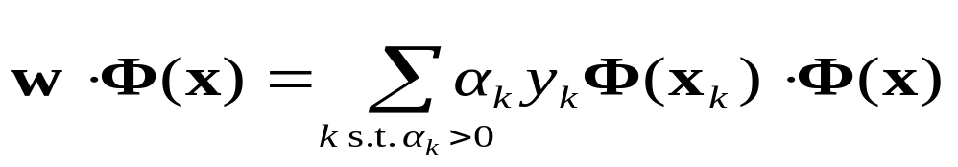
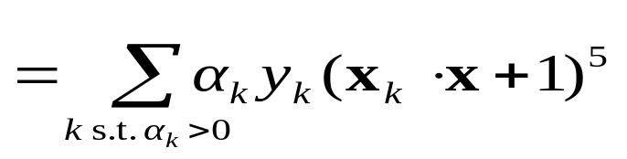
QP with Quintic basis functions
We must do R²/2 dot products to get this matrix ready.
In 100-d, each dot product now needs 103 operations instead of 75 million
But there are still worrying things lurking away. What are they?
Maximize
where
The use of Maximum Margin magically makes this not a problem
Subject to these constraints:
The fear of overfitting with this enormous number of terms
The evaluation phase (doing a set of predictions on a test set) will be very expensive (why?)
Then define:
Because each w. φ(x) (see below) needs 75 million operations. What can be done?
Only Sm operations (S=#support vectors)
Then classify with:
f(x,w,b) = sign(w. φ(x) - b)

Slide 58
QP with Quintic basis functions
We must do R²/2 dot products to get this matrix ready.
In 100-d, each dot product now needs 103 operations instead of 75 million
But there are still worrying things lurking away. What are they?
Maximize
where
The use of Maximum Margin magically makes this not a problem
Subject to these constraints:
The fear of overfitting with this enormous number of terms
The evaluation phase (doing a set of predictions on a test set) will be very expensive (why?)
Then define:
Because each w. φ(x) (see below) needs 75 million operations. What can be done?
Only Sm operations (S=#support vectors)
Then classify with:
f(x,w,b) = sign(w. φ(x) - b)
When you see this many callout bubbles on a slide it’s time to wrap the author in a blanket, gently take him away and murmur “someone’s been at the PowerPoint for too long.”

Slide 59
QP with Quintic basis functions
Maximize
where
Andrew’s opinion of why SVMs don’t overfit as much as you’d think:
No matter what the basis function, there are really only up to R parameters: α₁, α₂ .. α_{R}, and usually most are set to zero by the Maximum Margin.
Asking for small w.w is like “weight decay” in Neural Nets and like Ridge Regression parameters in Linear regression and like the use of Priors in Bayesian Regression---all designed to smooth the function and reduce overfitting.
Subject to these constraints:
Then define:
Only Sm operations (S=#support vectors)
Then classify with:
f(x,w,b) = sign(w. φ(x) - b)

Slide 60
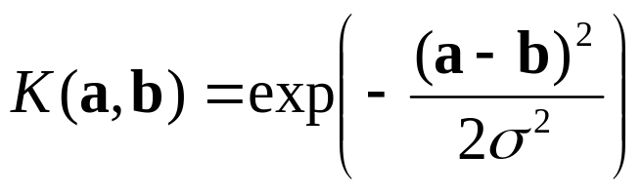

SVM Kernel Functions
K(a,b)=(a . b +1)^{d} is an example of an SVM Kernel Function
Beyond polynomials there are other very high dimensional basis functions that can be made practical by finding the right Kernel Function
  Radial-Basis-style Kernel Function:
  Neural-net-style Kernel Function:
σ, κ and δ are magic parameters that must be chosen by a model selection method such as CV or VCSRM*
*see last lecture

Slide 61
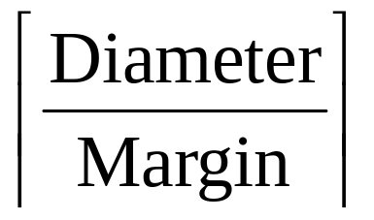
VC-dimension of an SVM
Very very very loosely speaking there is some theory which under some different assumptions puts an upper bound on the VC dimension as
where
  Diameter is the diameter of the smallest sphere that can enclose all the high-dimensional term-vectors derived from the training set.
  Margin is the smallest margin we’ll let the SVM use
This can be used in SRM (Structural Risk Minimization) for choosing the polynomial degree, RBF σ, etc.
  But most people just use Cross-Validation

Slide 62
SVM Performance
Anecdotally they work very very well indeed.
Example: They are currently the best-known classifier on a well-studied hand-written-character recognition benchmark
Another Example: Andrew knows several reliable people doing practical real-world work who claim that SVMs have saved them when their other favorite classifiers did poorly.
There is a lot of excitement and religious fervor about SVMs as of 2001.
Despite this, some practitioners (including your lecturer) are a little skeptical.

Slide 63
Doing multi-class classification
SVMs can only handle two-class outputs (i.e. a categorical output variable with arity 2).
What can be done?
Answer: with output arity N, learn N SVM’s
  SVM 1 learns “Output==1” vs “Output != 1”
  SVM 2 learns “Output==2” vs “Output != 2”
  :
  SVM N learns “Output==N” vs “Output != N”
Then to predict the output for a new input, just predict with each SVM and find out which one puts the prediction the furthest into the positive region.

Slide 64
References
An excellent tutorial on VC-dimension and Support Vector Machines:
    C.J.C. Burges. A tutorial on support vector machines for pattern recognition. Data Mining and Knowledge Discovery, 2(2):955-974, 1998. http://citeseer.nj.nec.com/burges98tutorial.html
The VC/SRM/SVM Bible:
    Statistical Learning Theory by Vladimir Vapnik, Wiley-Interscience; 1998

Slide 65
What You Should Know
Linear SVMs
The definition of a maximum margin classifier
What QP can do for you (but, for this class, you don’t need to know how it does it)
How Maximum Margin can be turned into a QP problem
How we deal with noisy (non-separable) data
How we permit non-linear boundaries
How SVM Kernel functions permit us to pretend we’re working with ultra-high-dimensional basis-function terms

